Slide 1
EARTHQUAKE PREDICTION MODEL USING PYTHON

Slide 2
ANALYZE AND VISLALIZE
Earthquake is a natural phenomenon whose occurrence predictability is still a hot topic in academia. This is because of the destructive power it holds. In this article, we’ll learn how to analyze and visualize earthquake data with Python and Matplotlib.

Slide 3
DATASET
Origin time of the Earthquake Latitude and the longitude of the location.
Depth – This means how much depth below the earth’s level the earthquake started.
The magnitude of the earthquake location.

Slide 4
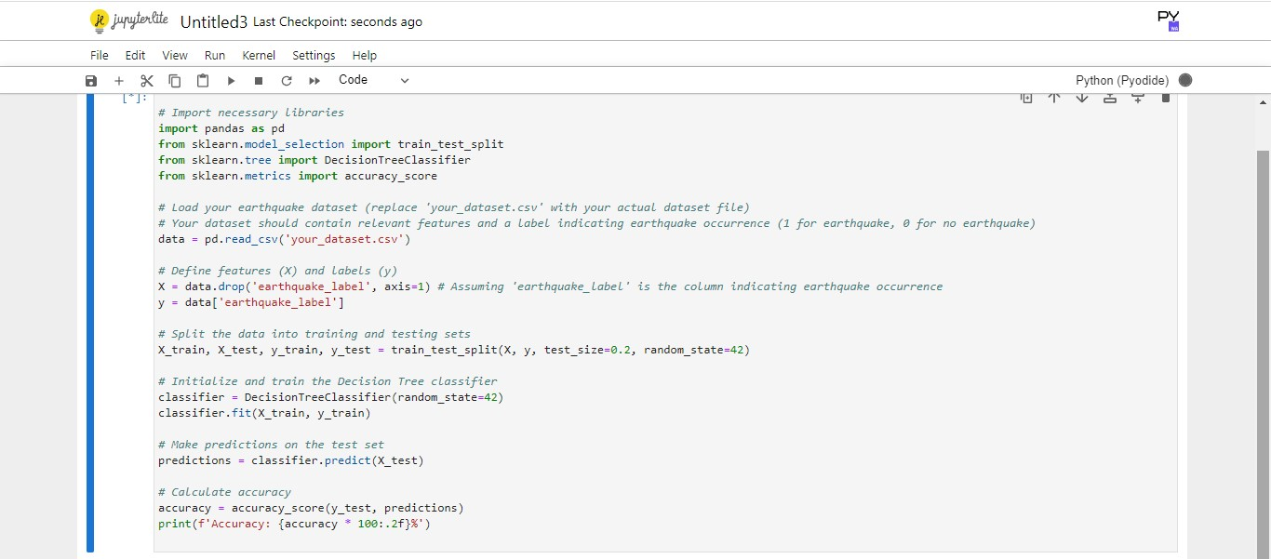

Slide 5
